Slide 1

DEVELOPEMENT OF THE BAT WING
By: Hugo Swenson, 1MB462 2018

Slide 2
Methodology
SOAPdenovo -> FASTQC
TRINITY -> QUAST
NCBI -> MAKER2
BOWTIE -> TOPHAT
SAMTOOLS -> HTSEQ
DESEQ2 + eggNOGmapper
RESULTS!

Slide 3
Quick data appendix
Base-mean = The mean of normalized counts of all samples
log2 fold change = Comparison of A vs B, A>B means that gene expression in A is larger in comparison to B.
lfcSE = tandard error of log2 Fold Change
stat = Wald statistic, the LFC divided by its standard error, determines significance

Slide 4
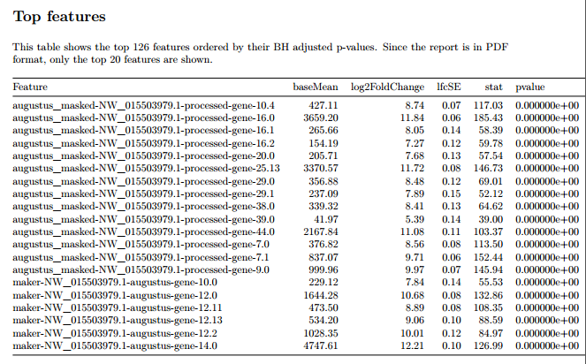

Slide 5
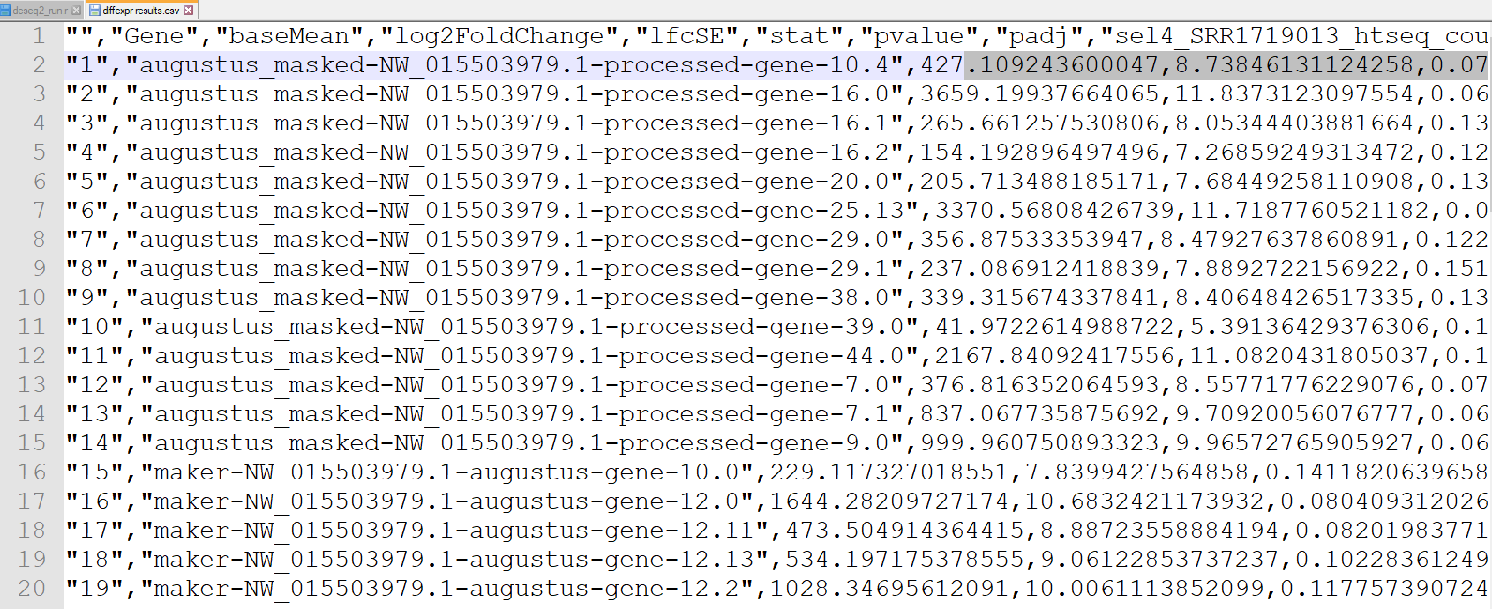

Slide 6
QC-Dispersion plot
Gene-wise MLEs obtained using only the respective gene’s data (black dots)
Curve (red) is fit to the MLEs to capture the overall trend of dispersion-mean dependence
This fit is used as prior mean for 2 round
This yields final MAP estimates
Shrinkage of the estimates toward the consensus represented by the red line

Slide 7
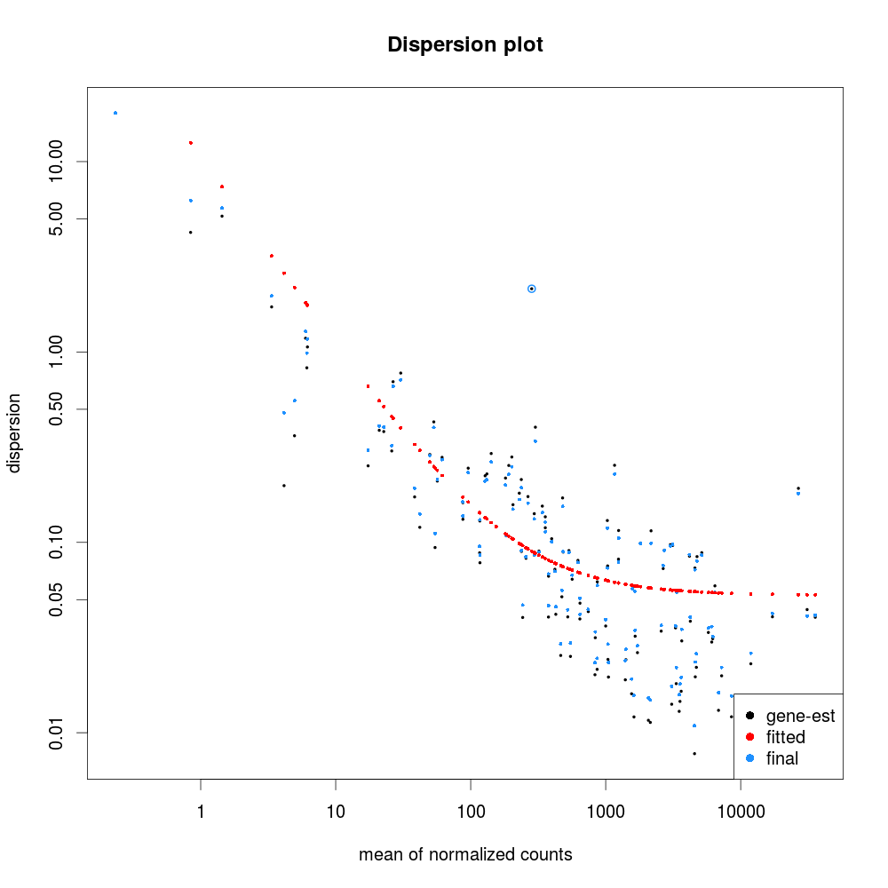

Slide 8
Counts plot
Norm-count vs group
Y axis is on the log10 scale
Feature name is shown in the title of each plot
Showing the two “best” genes
A total of 20 were mapped

Slide 9
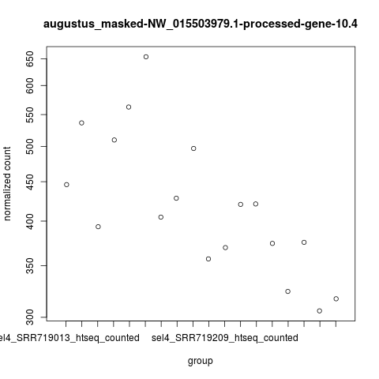

Slide 10
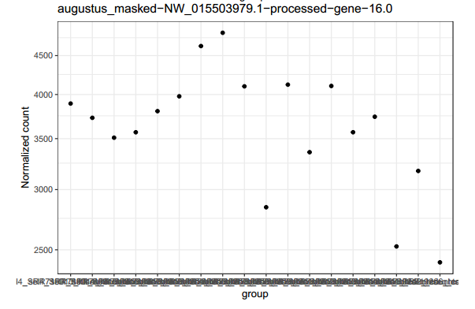

Slide 11
PCA
PCA is used to find the components with largest variation, bringing out strong patterns in a dataset
Reduces the dimension of the feature space studied
By reducing the dimension, fewer relationships between variables have to be considered
Allows us to vizualise high-dimensional data in lower dimensional space
Plot shows first two principal components that explain the variability in the data
(Uses regularized log count data.
Explain 31 and 26 percent of the variance respectively

Slide 12
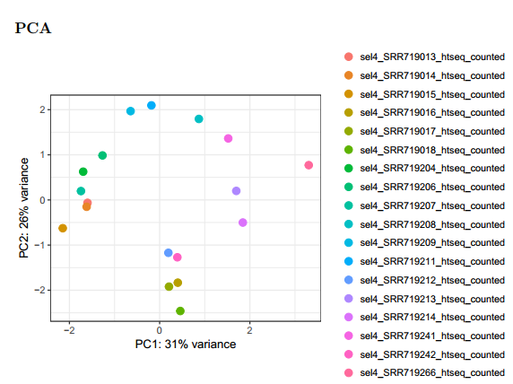

Slide 13
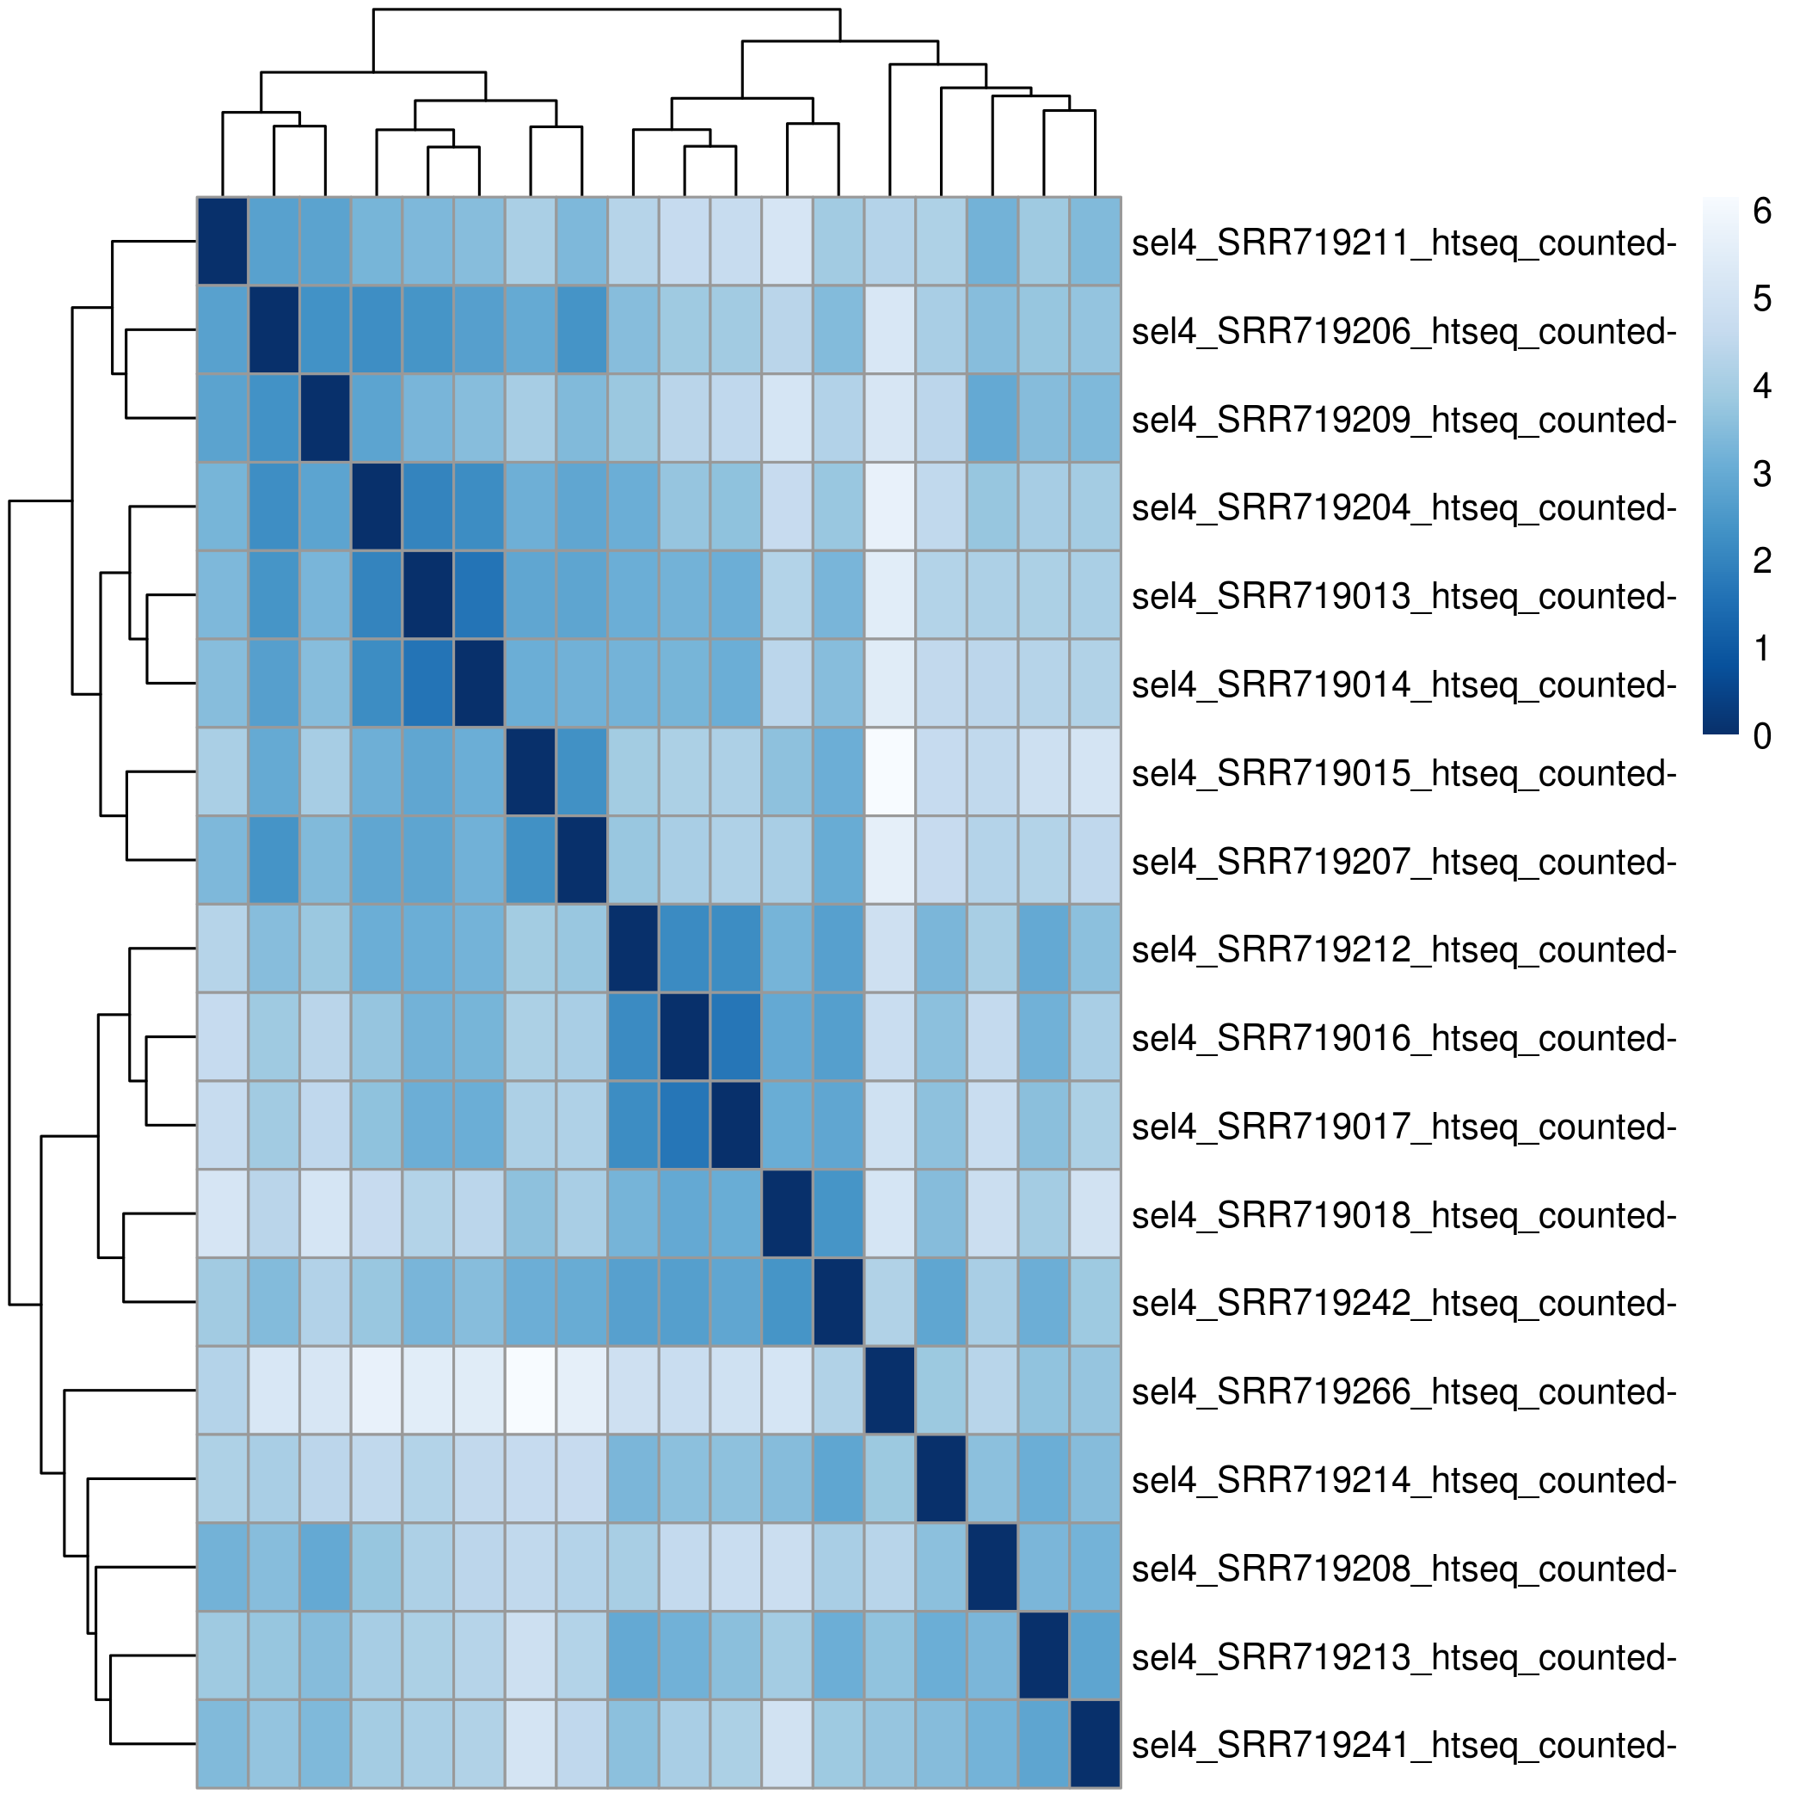
Dist-Heatmap
Performs a t-distribution on the assay of the rld-values
Complement to the PCA
Plot shows how samples are clustered based on their euclidean distance
Uses regularized log transformed count data.
Gives an overview of how the samples are hierarchically clustered

Slide 14
MA-plots
Compares the mean of the normalized counts against log fold change
Show one point per feature.
Points are shown in red if the feature has adjusted p-value less than alpha
Ie: statistically significant features are shown in red
Transforms the data onto log ratio and the mean average (M resp. A)
Shows intensity and difference between two data-sets
Log is used to keep plot within bounds
Ie : 8-fold increase will be displayed at an axis value of 3

Slide 15
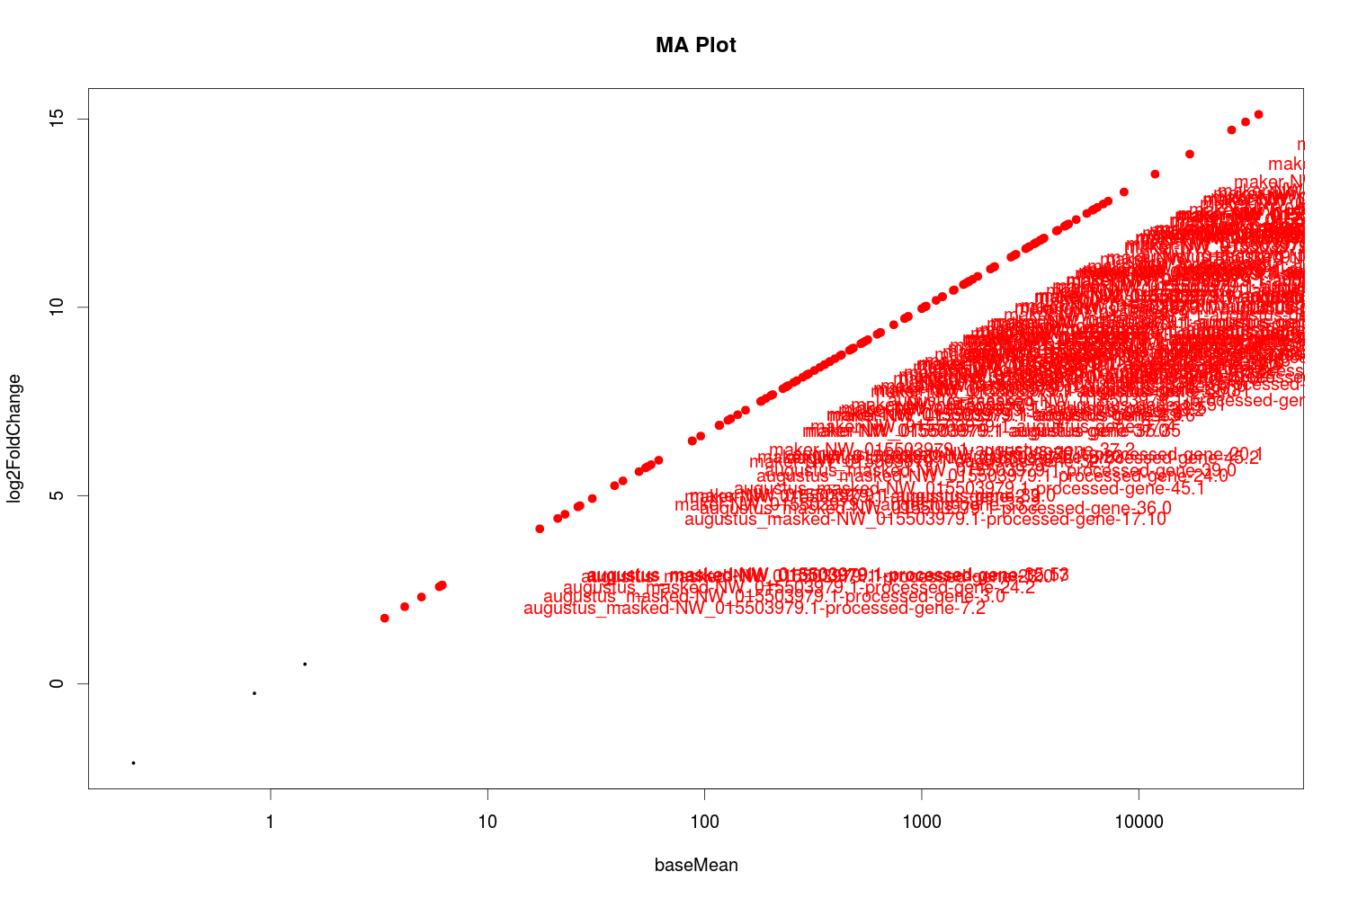

Slide 16
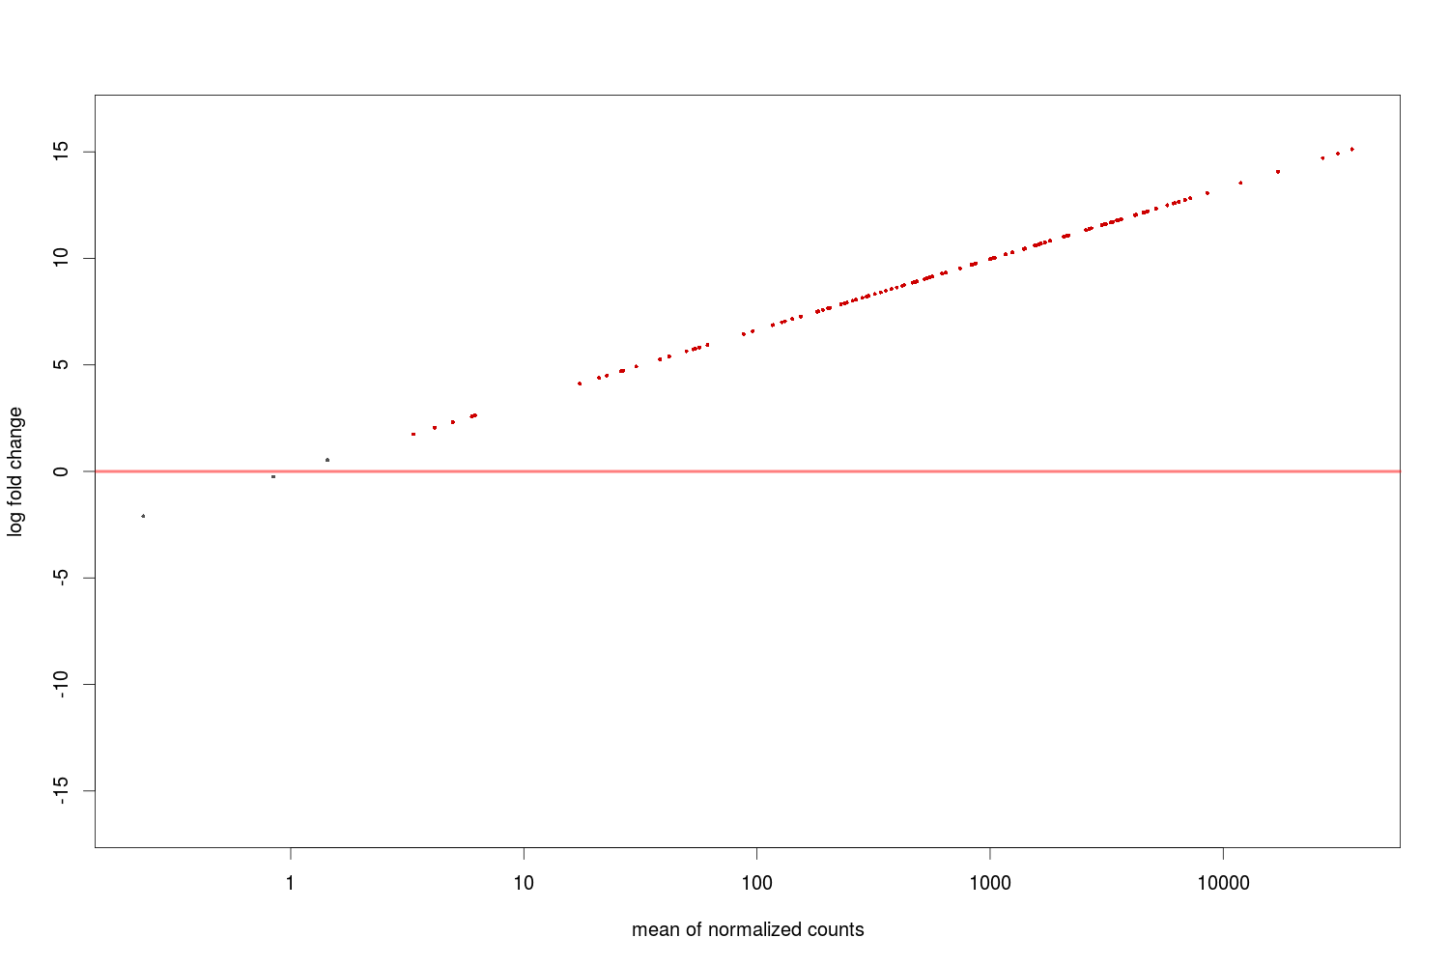

Slide 17
EggNOGmapper
masked 10.4 = Inherit from KOG: Breast carcinoma amplified sequence 3
masked 16.0 = Vacuole membrane protein
masked 16.1 = Peptidyl-tRNA hydrolase 2
masked 16.2 = Ubiquitin-conjugating enzyme E2L 3
masked 20.0 = Ligand for members of the frizzled family of seven transmembrane receptors
masked 25.13 = KAT8 regulatory NSL complex subunit 1
masked 29.0 - 29.1 = E3 ubiquitin protein ligase
augustus-gene 10.0 = K t-box transcription factor
augustus-gene 12.0 = Fanconi anemia group J protein-like
augustus-gene 12.11 - 12.13 - 12.2 = L helicase 1
augustus-gene 14.0 = ring finger protein, transmembrane 1

Slide 18
Gene-function
10.4 = Cytoskeletal protein that controls Cdc42 activation and directional cell migration during angiogenesis.
16.0 = Stress-induced protein that, when overexpressed, promotes formation of intracellular vacuoles followed by cell death.
16.1 Peptidyl-tRNA hydrolases are enzymes that release tRNAs from peptidyl-tRNA during translation
16.2 = Ubiquitin-conjugating enzyme E2 that specifically acts with HECT-type and RBR family E3 ubiquitin-protein ligases
25.13 = Involved in acetylation of nucleosomal histone H4 on several lysine residues
Gene-10.0 = T-box refers to a group of transcription factors involved in limb and heart development
Gene-12-0 = DNA-dependent ATPase and 5' to 3' DNA helicase required for the maintenance of chromosomal stability

Slide 19
TBX-2
No Hoxd10, Hoxd11, Meis2, Pitx1 were found, TBX2 only lead
Tbx genes are involved in limb initiation, by interacting with Wnts and Fgfs
Wang Z, Dong D, Ru B, Young RL, Han N, Guo T, et al. Digital gene expression tag profiling of bat digits provides robust candidates contributing to wing formation. BMC Genomics. 2010 Nov 6;11:619.
Authors found “ significant forelimb (FL) versus hindlimb (HL) expression changes by stage.” when studying Tbx5-as1 and Hottip expression profiles
TBX2 is part of the same family as TBX5, and an active gene in limb-development
“ lncRNAs could also have a strong influence on wing development, with observed forelimb/hindlimb expression differences for Hottip and Tbx5-as1”

Slide 20
Conclusion
TBX-2 involved in limb-developement
Diffseq-results and eggNOGmapper point towards divergence
As TBX-Family is linked to limb development, possible gene
More data is required before drawing definite conclusions
Paper-II studied TBX-5 = same family as TBX-2
Lack of data and time limited project
No ChlP-seq = No DNA-Prot interactions

Slide 21
Sources:
Wang Z, Dong D, Ru B, Young RL, Han N, Guo T, et al. Digital gene expression tag profiling of bat digits provides robust candidates contributing to wing formation. BMC Genomics. 2010 Nov 6;11:619.
Eckalbar WL, Schlebusch SA, Mason MK, Gill Z, Parker AV, Booker BM, et al. Transcriptomic and epigenomic characterization of the developing bat wing. Nat Genet. 2016 May;48(5):528–36..
Bioconductor - Home [Internet]. [cited 2018 May 24]. Available from: https://bioconductor.org
EggNOG Database | Orthology predictions and functional annnotaion [Internet]. [cited 2018 May 24]. Available from: http://eggnogdb.embl.de/#/app/home

Slide 22
THANK YOU FOR
LISTENING!
AATCCGGCCCGGGAAATTTAUAAGATTTCCCGTTCT GTTGCCGGATTUCCGATTTCCCGCTCTCTCTTCTCTC
AAATTTTGCUAGTCCCTTTCGCGGCCTTAAAAUGTC
AATCCGGCCCGGGAAATTTAUAAGATTTCCCGTTCT GTTGCCGGATTUCCGATTTCCCGCTCTCTCTTCTCTC
AAATTTTGCUAGTCCCTTTCGCGGCCTTAAAAUGTC
GTTGCCGGATTUCCGATTTCCCGCTCTCTCTTCTCTC
AAATTTTGCUAGTCCCTTTCGCGGCCTTAAAAUGTC
AATCCGGCCCGGGAAATTTAUAAGATTTCCCGTTCT GTTGCCGGATTUCCGATTTCCCGCTCTCTCTTCTCTC
AAATTTTGCUAGTCCCTTTCGCGGCCTTAAAAUGTC

